Slide 1
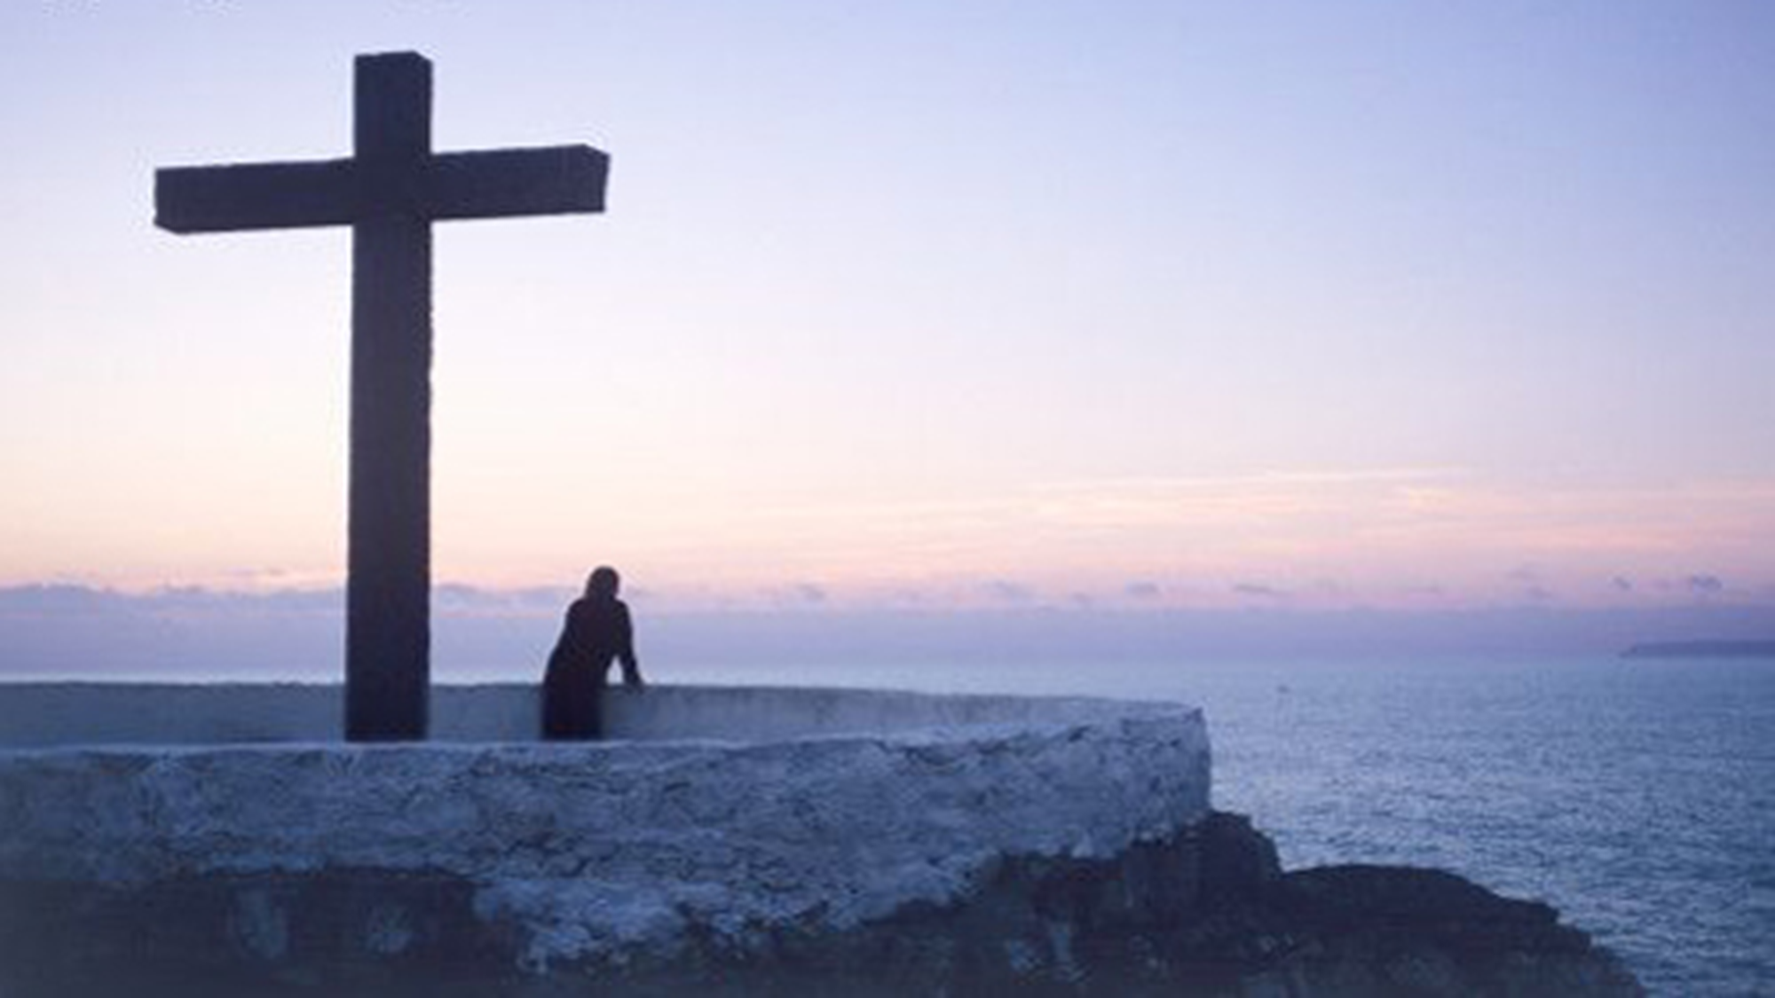
今生跟随主耶稣
今生跟随主耶稣
This Life To Following You
词：马健涛，李冰 / 曲：马健涛
當我認識你那一刻起
我的心都交給了你
當我信仰你那一刻起
我就是你的兒女
From the moment I knew you
I give my heart to you
From the moment I believed in you
I am your child

Slide 2
今生跟随主耶稣
當我認識你那一刻起
我的心都交給了你
當我信仰你那一刻起
我就是你的兒女
From the moment I knew you
I give my heart to you
From the moment I believed in you
I am your child
當我認識你那一刻起
我的心都交給了你
當我信仰你那一刻起
我就是你的兒女
From the moment I knew you
I give my heart to you
From the moment I believed in you
I am your child

Slide 3
今生跟随主耶稣
當我徘徊在痛苦的邊緣
是你伸出你的手
當幸福來敲門的時候
我知道那是你的恩典
When I hovered on the brink of pain
You reached out your hand
When blessings befall me,
I know that it is by your grace
當我認識你那一刻起
我的心都交給了你
當我信仰你那一刻起
我就是你的兒女
From the moment I knew you
I give my heart to you
From the moment I believed in you
I am your child

Slide 4
今生跟随主耶稣
你的恩典充滿世界每個角落
讓人平安讓人有喜樂
今生跟隨主耶穌
你是我的主
你用寶血洗淨了我們
Your grace fills every corner of the world
Giving people peace and joy
Lord Jesus, I will follow you with my life
You are my Lord
Wash us with your precious blood
當我認識你那一刻起
我的心都交給了你
當我信仰你那一刻起
我就是你的兒女
From the moment I knew you
I give my heart to you
From the moment I believed in you
I am your child

Slide 5
今生跟随主耶稣
生命中如果沒有神的指引
世間繁華將沖淡我心
今生跟隨主耶穌
你是我的主
願背十字架一輩子
If God’s guidance is not in my life
All the world’s attractions would dilute my heart
Lord Jesus, I will follow you in this life
You are my Lord
I am willing to carry the cross all my life
當我認識你那一刻起
我的心都交給了你
當我信仰你那一刻起
我就是你的兒女
From the moment I knew you
I give my heart to you
From the moment I believed in you
I am your child

Slide 6
今生跟随主耶稣
當我認識你那一刻起
我的心都交給了你
當我信仰你那一刻起
我就是你的兒女
From the moment I knew you
I give my heart to you
From the moment I believed in you
I am your child
當我認識你那一刻起
我的心都交給了你
當我信仰你那一刻起
我就是你的兒女
From the moment I knew you
I give my heart to you
From the moment I believed in you
I am your child

Slide 7
今生跟随主耶稣
當我徘徊在痛苦的邊緣
是你伸出你的手
當幸福來敲門的時候
我知道那是你的恩典
When I hovered on the brink of pain
You reached out your hand
When blessings befall me,
I know that it is by your grace
當我認識你那一刻起
我的心都交給了你
當我信仰你那一刻起
我就是你的兒女
From the moment I knew you
I give my heart to you
From the moment I believed in you
I am your child

Slide 8
今生跟随主耶稣
你的恩典充滿世界每個角落
讓人平安讓人有喜樂
今生跟隨主耶穌
你是我的主
你用寶血洗淨了我們
Your grace fills every corner of the world
Giving people peace and joy
Lord Jesus, I will follow you with my life
You are my Lord
Wash us with your precious blood
當我認識你那一刻起
我的心都交給了你
當我信仰你那一刻起
我就是你的兒女
From the moment I knew you
I give my heart to you
From the moment I believed in you
I am your child

Slide 9
今生跟随主耶稣
生命中如果沒有神的指引
世間繁華將沖淡我心
今生跟隨主耶穌
你是我的主
願背十字架一輩子
If God’s guidance is not in my life
All the world’s attractions would dilute my heart
Lord Jesus, I will follow you in this life
You are my Lord
I am willing to carry the cross all my life
當我認識你那一刻起
我的心都交給了你
當我信仰你那一刻起
我就是你的兒女
From the moment I knew you
I give my heart to you
From the moment I believed in you
I am your child

Slide 10
今生跟随主耶稣
你的恩典充滿世界每個角落
讓人平安讓人有喜樂
今生跟隨主耶穌
你是我的主
你用寶血洗淨了我們
Your grace fills every corner of the world
Giving people peace and joy
Lord Jesus, I will follow you with my life
You are my Lord
Wash us with your precious blood
當我認識你那一刻起
我的心都交給了你
當我信仰你那一刻起
我就是你的兒女
From the moment I knew you
I give my heart to you
From the moment I believed in you
I am your child

Slide 11
今生跟随主耶稣
生命中如果沒有神的指引
世間繁華將沖淡我心
今生跟隨主耶穌
你是我的主
願背十字架一輩子
If God’s guidance is not in my life
All the world’s attractions would dilute my heart
Lord Jesus, I will follow you in this life
You are my Lord
I am willing to carry the cross all my life
當我認識你那一刻起
我的心都交給了你
當我信仰你那一刻起
我就是你的兒女
From the moment I knew you
I give my heart to you
From the moment I believed in you
I am your child

